Slide 1
General Guidelines for Presentation
Slides should not be too heavy with content. Better to create point wise.
If you require more than one slide for any point, right click on that point slide then select duplicate slide and modify the duplicated slide.
Diagrams must be aligned at centre and clearly visible with caption.
All the mentioned fonts, font size, title content, etc should not change and strictly as per the given format and guidelines.

Slide 2

Smart Plate
Group members with Student Id
Shweta Bhutada 21104007
Manjiri Gole 21104006
Akshata Nalavade 21104003
Project Guide
Prof. Sonal Balpande

Slide 3
Contents
Introduction
Objectives
Scope
Literature Survey
Proposed System
Project Outcomes
Block Diagram
Use Case/DFD
Technology Stack

Slide 4
1. Introduction
A user-friendly website for an online recipe box ordering service that enables customers to easily browse, customize, and order recipe boxes with pre-portioned ingredients and step-by-step cooking instructions.
Problem Identified :
Busy lifestyle mean less time for meal planning, grocery shopping, and cooking.
People enjoy cooking but lack time/resources for ingredients.
People cook the same dishes repeatedly due to routine.
Solution Proposed :
Caters to busy individuals and families, streamlining meal planning.
Delivers fresh ingredients and recipes to your door, saving time.

Slide 5
2. Objectives
To offer a convenient solution for busy individuals.
To enabling them to enjoy home-cooked meals without the hassle of meal planning and providing them with fresh ingredients.
To provide a diverse range of recipes from various cuisines so they can explore different cuisines.
To design pre-portioned ingredients so that food doesn’t go to waste and if they don’t have an ingredient they won’t have to buy it for only one serving as it can be infeasible sometimes.

Slide 6
3. Scope
Suggest and recommend users recipes based on their previous ordering and their search history
Including and offering a diverse range of recipes from various cuisines, catering to different dietary preferences and skill levels so users can explore what they like.
Users can customize recipes to their dietary requirements and ingredient preferences, providing a tailored cooking experience.
Create weekly meal plans for users so that they can order all meals together making it cost effective and time saving.

Slide 7
4. Literature Survey
The current study has examined such a disruption of household routines: the meal box. We examined three types of food waste: preparation, cooking, and plate waste. For preparation waste, we expected less food waste for meal boxes compared to traditional meals. This could be due to the fresh ingredients in the meal boxes, which could lead to a small amount of preparation waste. For cooking waste, incorrect portion size estimation is key as well as buying in excessive amounts.
With this information at their fingertips, providers can curate tailored recipe suggestions that align with each customer's unique tastes and lifestyle. Personalization goes beyond just recipe recommendations; it extends to portion sizes, frequency of deliveries, and even delivery schedules. Machine learning algorithms further enhance personalization by continuously analyzing customer data and adapting recommendations over time. This dynamic approach ensures that the meal kit service evolves with the customer's changing tastes and needs.

Slide 8
5. Proposed System
Features & Functionality we are planning to implement:
Recipe Exploration and Selection
    Categorized recipe collections based on cuisines, dietary preferences, difficulty levels, and more.
    Detailed recipe pages with images, ingredients, instructions, nutritional information.
User login authentication
Customization and Personalization (Future Implementation)
dietary preferences including allergens
4. Feedback and Reviews
Ratings and reviews for recipes to assist other users in their selections
5. Cart and Checkout

Slide 9
6. Methodology
Wireframing and Prototyping: We created wireframes and prototypes of the website's user interface (UI) to visualize the layout and user flow.
Architecture Design: Planned the overall system architecture, including the frontend, backend, and database components.
Frontend Development: Started to develop the user interface of the recipe website using HTML, CSS.
Backend Development: We have build the server-side logic using Node.js and Express.js. Implemented database interactions, user authentication after user login.
Database Implementation: Used the database system MongoDB and create the necessary collections and indexes.
Integration: Connected the frontend and backend components to ensure seamless communication. Further we are going to implement features like search, recommendation through feedback and reviews, order customization.

Slide 10
7. Outcome of Project
Portioned ingredients help minimize food waste by providing the exact quantities each recipe.
Enables users to enjoy restaurant-quality meals in the comfort of their own homes.
Providing a seamless, user-friendly experience can lead to high customer satisfaction.
Users can enjoy convenient meal planning and preparation, saving time.

Slide 11
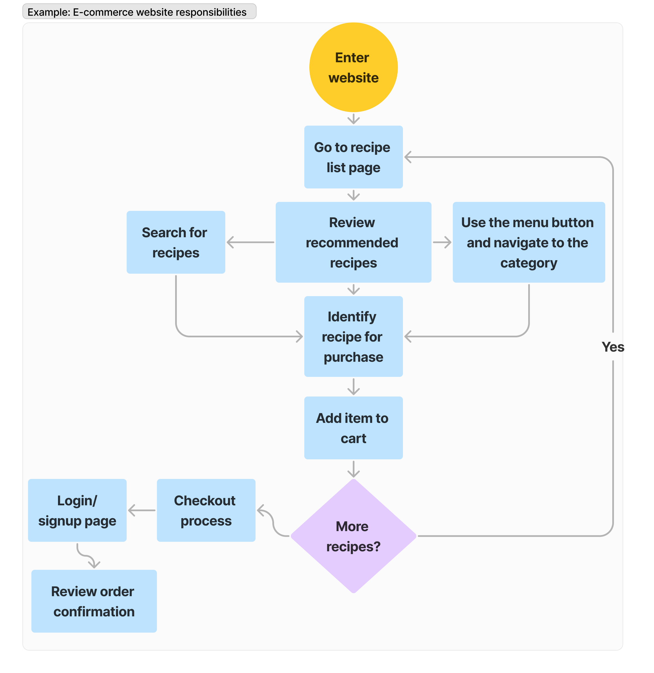
8. Block Diagram

Slide 12
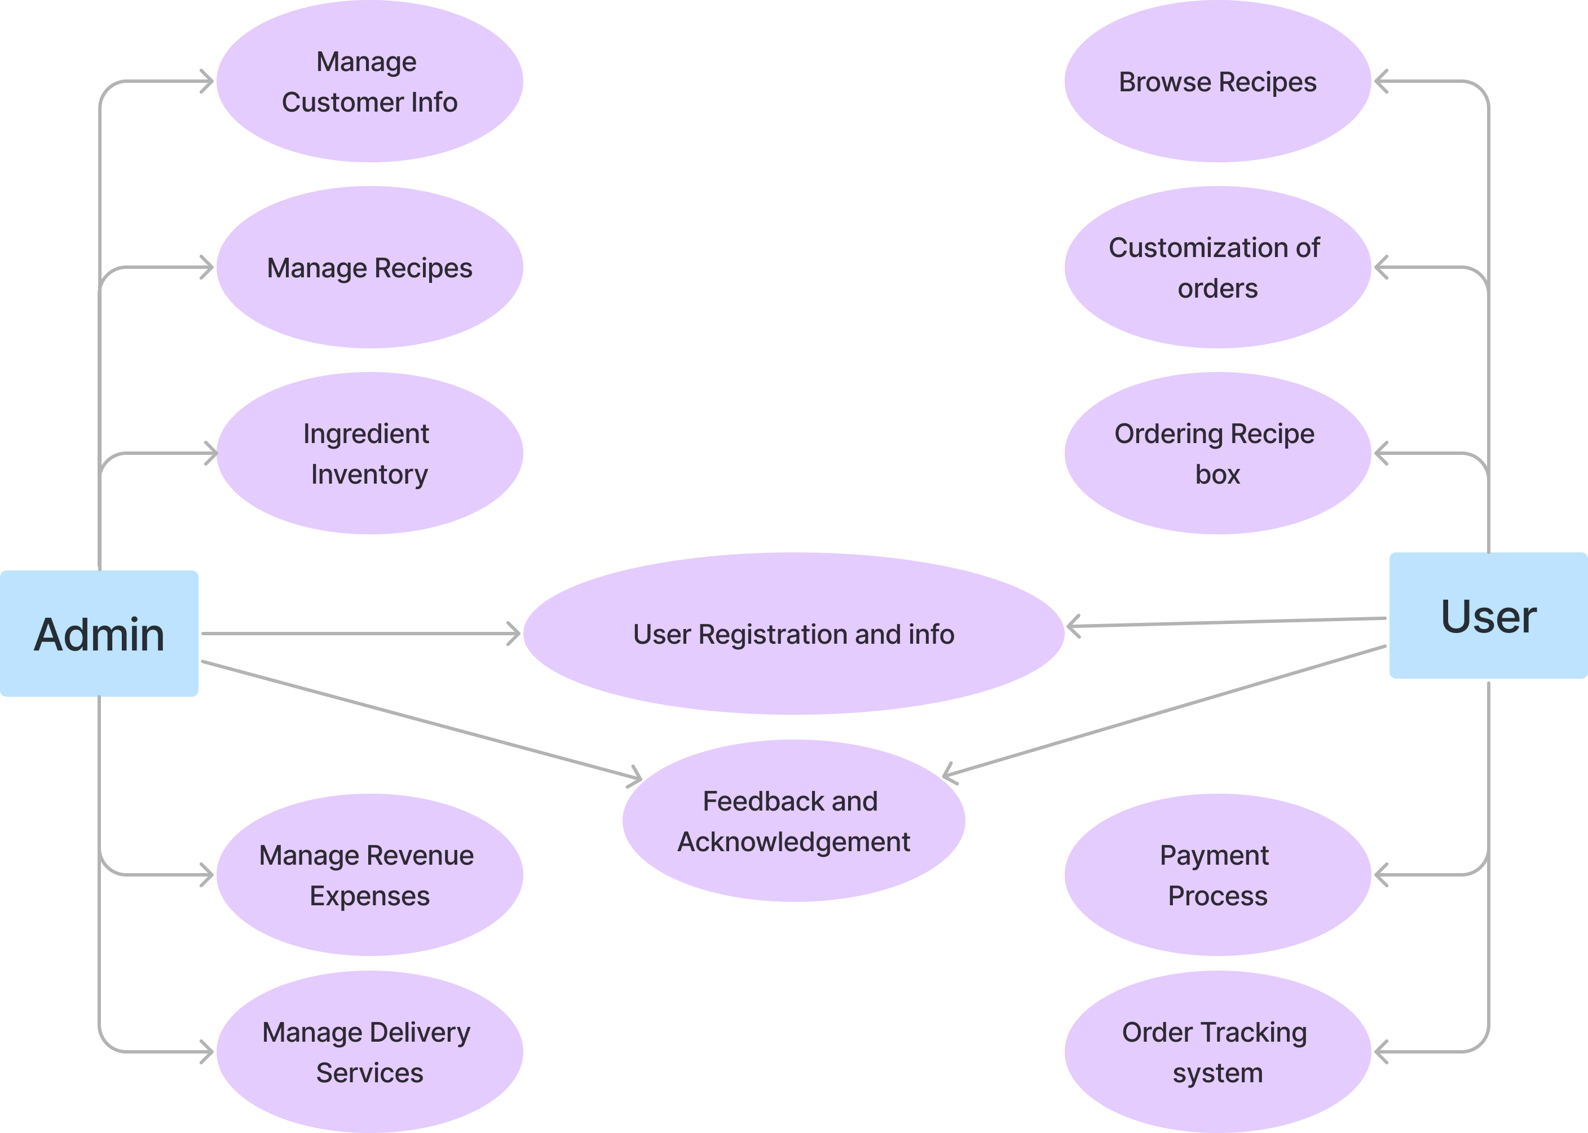
9. Use Case/Data Flow Diagram

Slide 13
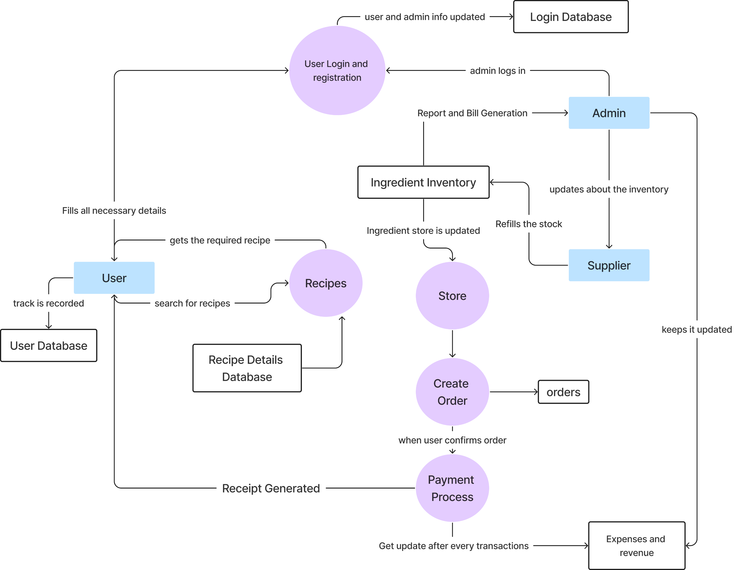
Data Flow Diagram – Level 1

Slide 14
10. Technology Stack
Write what you have planned to develop front end ( GUI ) & Backend (Database if applicable)
HTML&CSS
JavaScript
Database - MongoDB
NodeJs

Slide 15
Thank You...!!

